Slide 1

ACTIVITY PREDICTION OF THE ELDERLY
SRM INSTITUTE OF SCIENCE AND TECHNOLOGY
COLLEGE OF ENGINEERING AND TECHNOLOGY
DEPARTMENT OF NETWORKING AND COMMUNICATIONS
18CSP107L / 18CSP108L- MINOR PROJECT / INTERNSHIP
Student 1 Reg No: RA1911028010032
Student 2 Reg No: RA1911029010089
Batch ID: NWC032089
Guide name and Designation: Mrs. G. Parimala, Assistant Professor

Slide 2
TABLE OF CONTENTS
S.NO. | TITLE | SLIDE NO.
1. | INTRODUCTION | 3
2. | OBJECTIVES | 4
3. | LITERATURE SURVEY | 5
4. | BLOCK DIAGRAM | 7
5. | ARCHITECTURE DIAGRAM | 8
6. | UML DIAGRAMS | 10
7. | ALGORITHMS USED | 13

Slide 3
INTRODUCTION
•This is a web based application for a smart healthcare monitoring system.
•This application is made for the elderly people living alone in developing countries to predict their activity through wristbands connected to mobile application which will monitor their activity status.
•This application employs Artificial Intelligence and Machine Learning techniques such as Decision Tree Classifiers and Logistic Regressors.

Slide 4
OBJECTIVES
The objective of the project is to gain the insight about the activities of the elderly and to predict their movements that could be useful to them and is easily assessable as well as operable.
Our project's objective is to gather information through wristbands connected to the mobile application that will determine how active a person is depending on the physical activities they engage in.
The application project uses a machine learning-based fall detector and multi-agent architecture for contacting emergency assistance.

Slide 5
LITERATURE SURVEY
Title | Year | Achievements | Limitations/Suggestions
Activities Recognition, Anomaly Detection and Next Activity Prediction Based on Neural Networks in Smart Homes | 2022 | The proposed approach consists of three stages which are activity recognition, anomaly detection and next activity prediction. Such a system can provide useful information for the elderly, caregivers and medical teams to identify activities and generate preventive and corrective measures. | A clean sequence of activities has been constructed by discarding the anomalous instances. Future work needed to handle the imbalance dataset to improve the deep learning models.
Jointly Prediction of Activities, Locations, and Starting Times for Isolated Elderly People | 2021 | This paper proposes a multi- task activity prediction system that jointly predicts labels, locations, and starting times of future activities. Uses body activity information from wearable sensors and motion information from passive environmental sensors to sense activities of daily living of older adults. | These systems can provide better services to assist older people if it anticipates what activities inhabitants will perform ahead of time.

Slide 6
Title | Year | Achievements | Limitations/Suggestions
Health status prediction for the elderly based on machine learning | 2020 | The machine learning methods help researchers select the predictors of health status in the older population efficiently. The artificial neural networks have the best prediction accuracy in relation to older people's self-reported health. | Researchers are challenged with developing advanced techniques to examine the datasets as well as identifying the appropriateness to build a predictive model
Fall Detection For elderly patients -DRT | 2019 | Chosen Random Classifier with parameters like max_depth as 50 and n_estimators as 200 along with a threshold of 0.4 To be the best model not only because of the highest accuracy scores but also because it has the lowest false negative rate. | The cost is comparatively low because the assumption is that companies prevalent already in the healthcare field will adopt this solution.

Slide 7
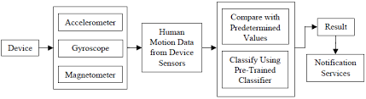
BLOCK diagram

Slide 8
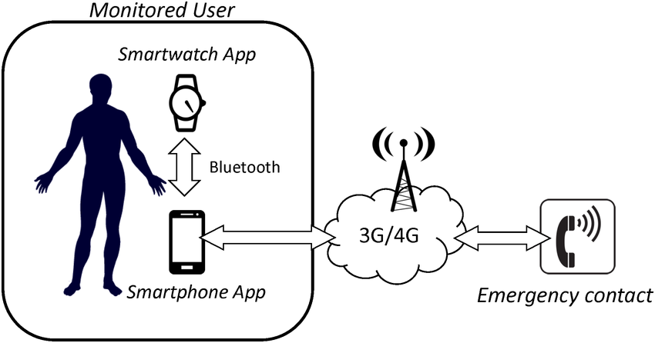
ARCHITECTURE diagram

Slide 9
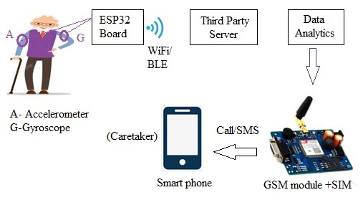

Slide 10
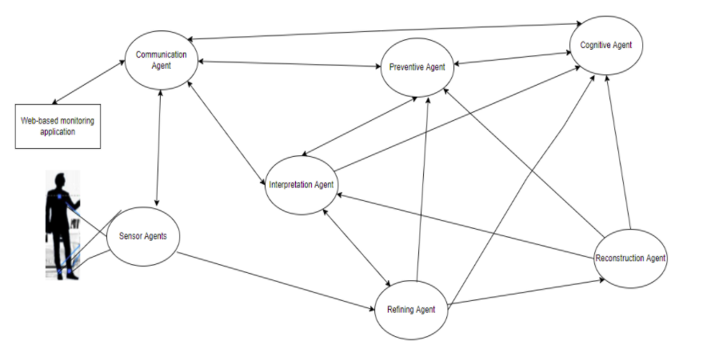
UML Diagrams MULTI AGENT ARCHITECTURE

Slide 11
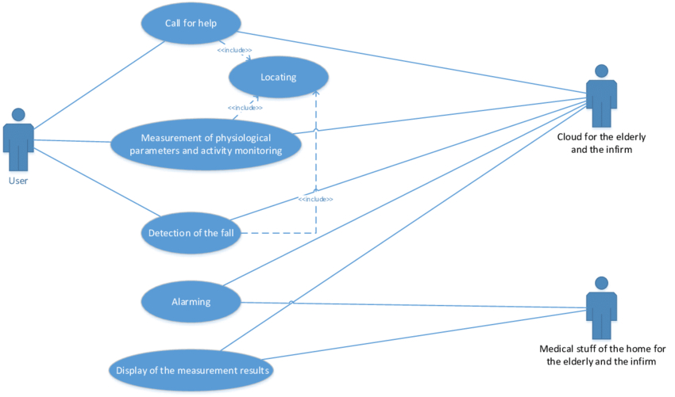
Use case diagram of the service for monitoring activities and location of users

Slide 12
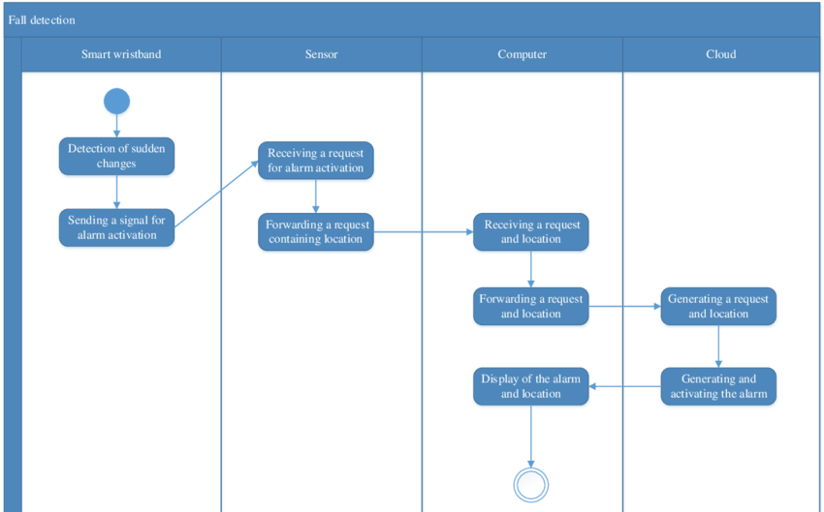
ACTIVITY DIAGRAM

Slide 13
ALGORITHMS USED
MODELLING: SKLEARN
Principal component analysis
Decision tree Classifier
Supervised Machine Learning where the data is continuously split according to a certain parameter.
Logistic Regression
Logistic regression is a statistical analysis method to predict a binary outcome, such as yes or no, based on prior observations of a data set.
Library provides a selection of efficient tools for machine learning and statistical modelling including classification, regression, clustering etc.
PCA is often used to simplify data, reduce noise, and find unmeasured “latent variables”.
K Neighbors Classifier
KNN is mostly used to classifies a data point based on how its neighbours are classified.

Slide 14
Thanks

